Slide 1
Machine Learning Algorithms

Slide 2
Introduction
To solve a problem on a computer, we need an algorithm.
An algorithm is a sequence of instructions that should be carried out to transform the input to output.
For example, one can devise an algorithm for sorting.
For some tasks, however, we do not have an algorithm—for example, to tell spam emails from legitimate emails.
What we lack in knowledge, we make up for in data.
We can easily compile thousands of example messages some of which we know to be spam and what we want is to “learn” what constitutes spam from them.

Slide 3
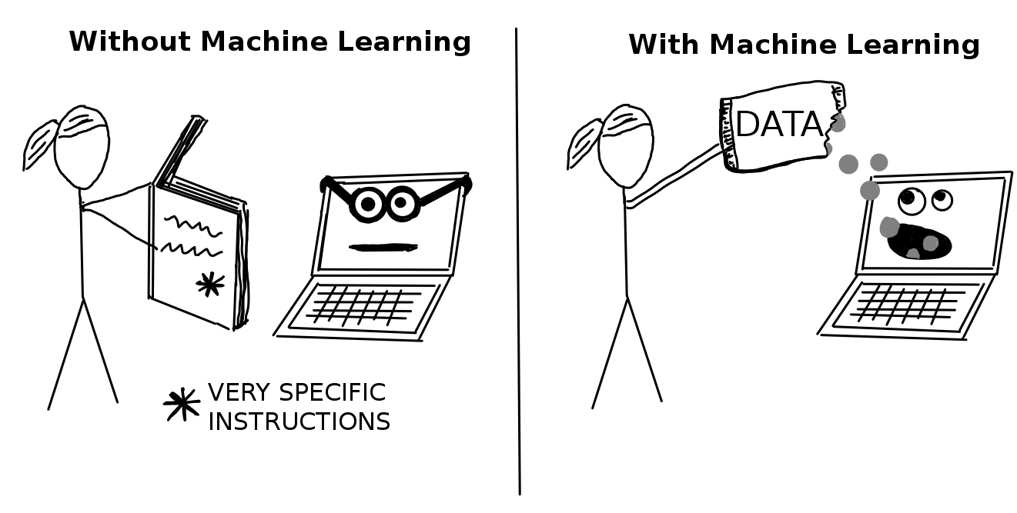
Machine Learning

Slide 4
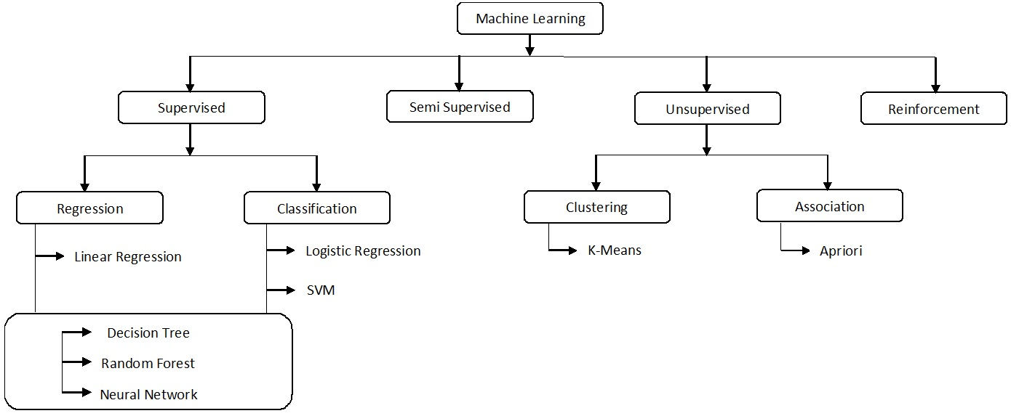
Machine Learning Models

Slide 5
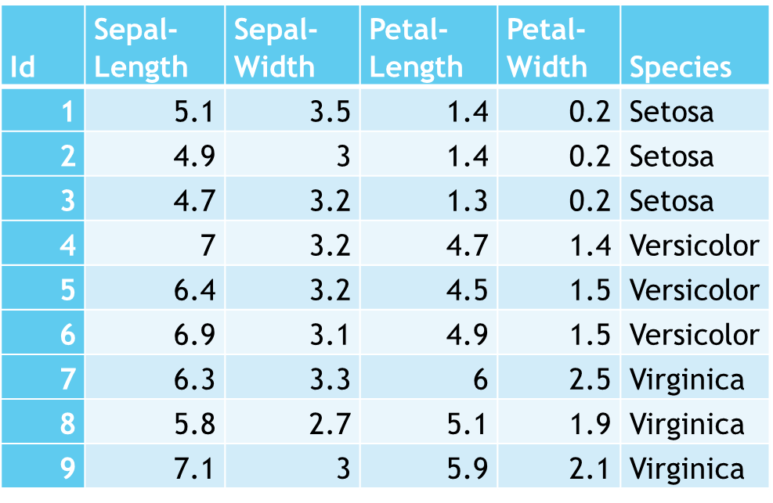
Reading a dataset
Continuous Data
Categorical Data
ID | Marital Status | Race | Sex
1 | Widowed | White | Female
2 | Widowed | White | Female
3 | Widowed | Black | Female
4 | Divorced | White | Female
5 | Separated | White | Female
6 | Divorced | White | Female
7 | Separated | White | Male
8 | Never-married | White | Female
9 | Divorced | White | Female
10 | Never-married | White | Male
Income
<=50K
<=50K
<=50K
<=50K
<=50K
<=50K
<=50K
>50K
<=50K
>50K
Continuous Data
Categorical Data
Targets (Categorical / Continuous )
Features / Attributes
Classes
Training Set / Testing Set

Slide 6
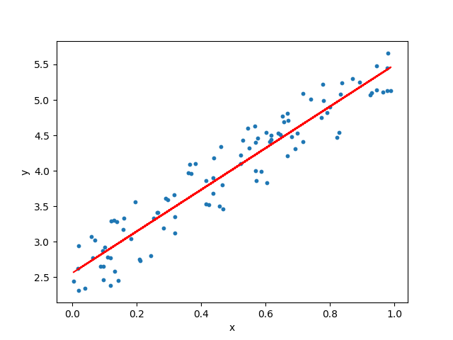
Regression: Linear Regression
Input: Finite range of Continuous Values.
Output: Finite range of Continuous Values.

Slide 7
Regression

Slide 8
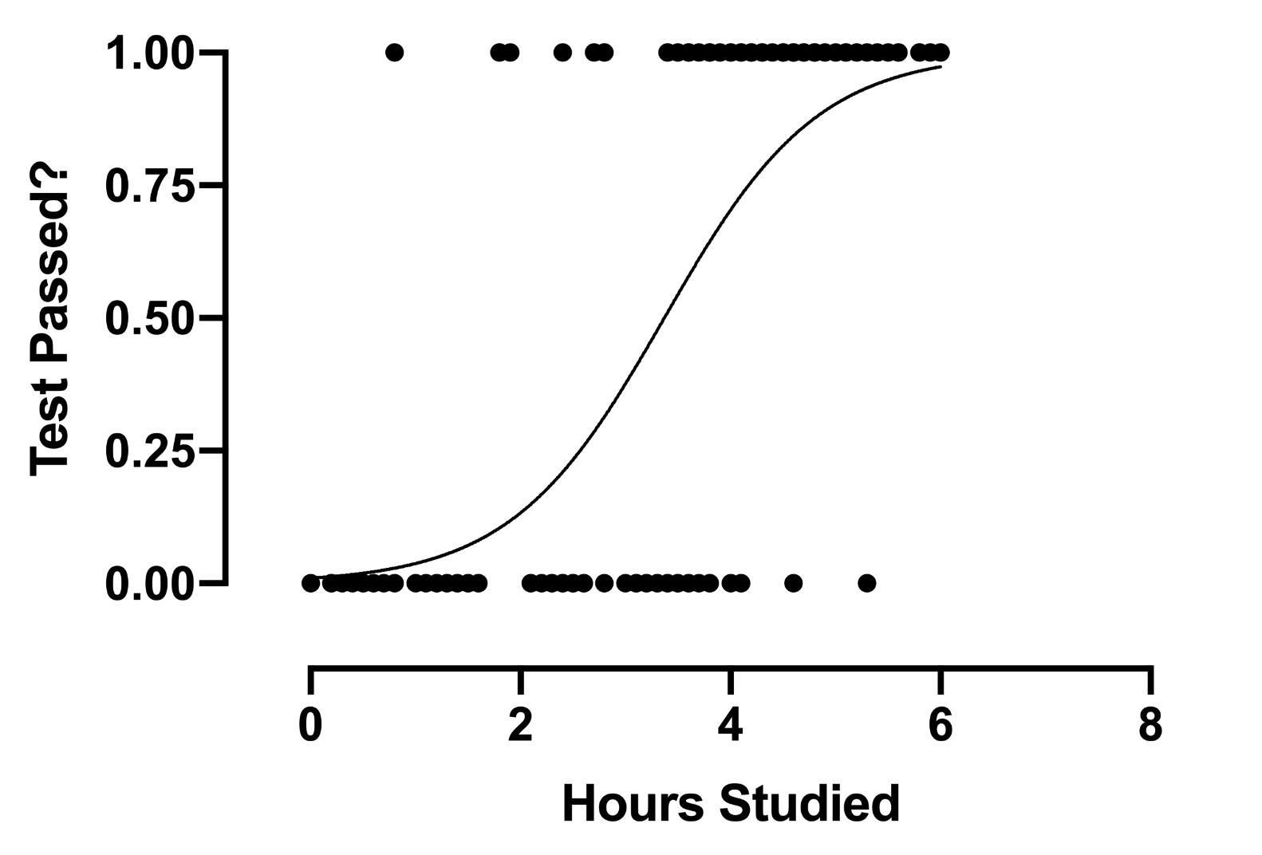
Classification: Logistic Regression
Input: Finite range of Continuous Values.
Output: Categorical.

Slide 9
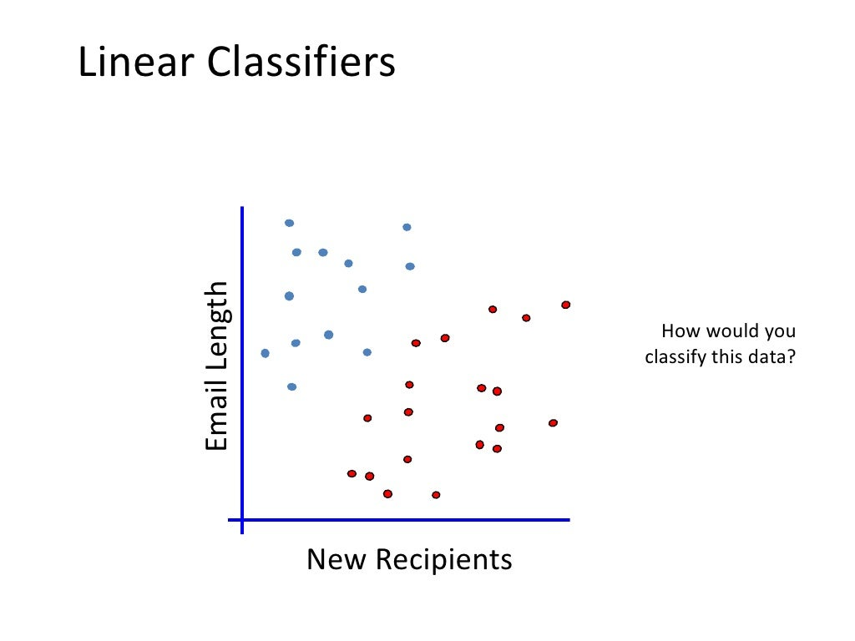

Slide 10
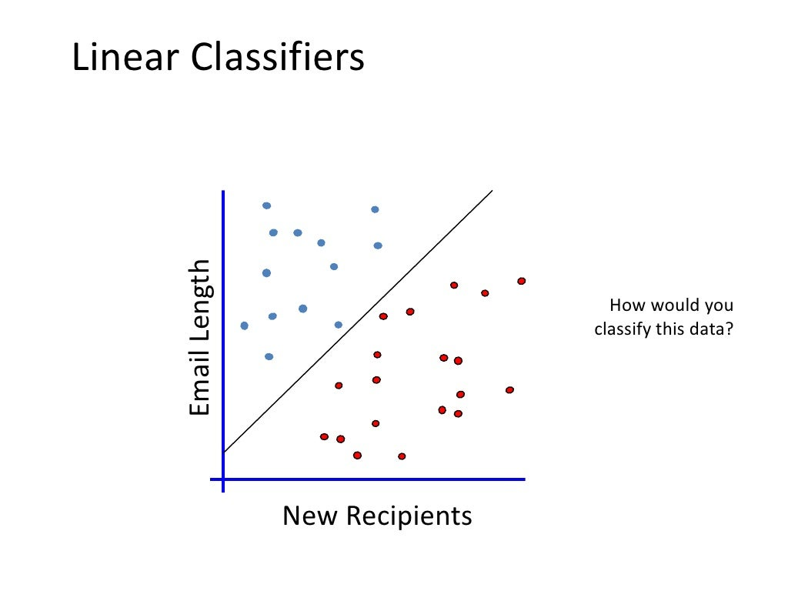

Slide 11
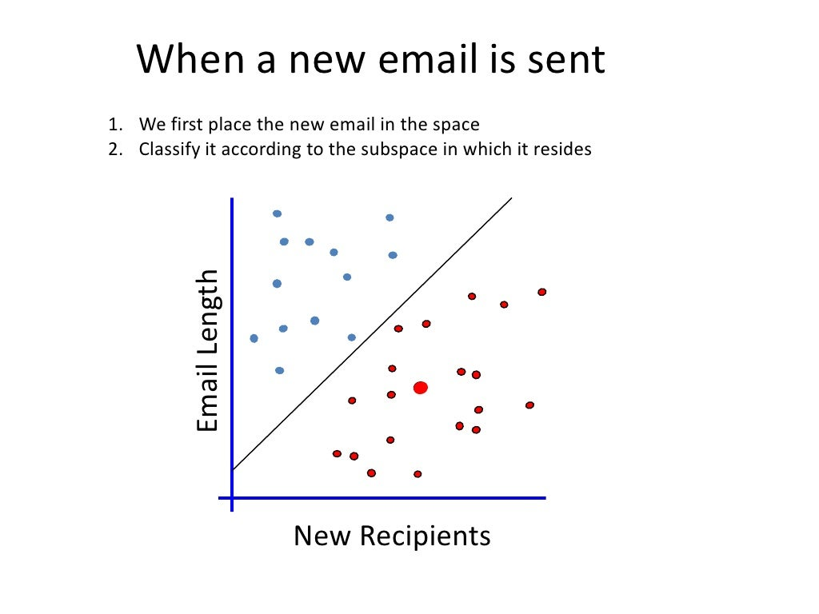

Slide 13
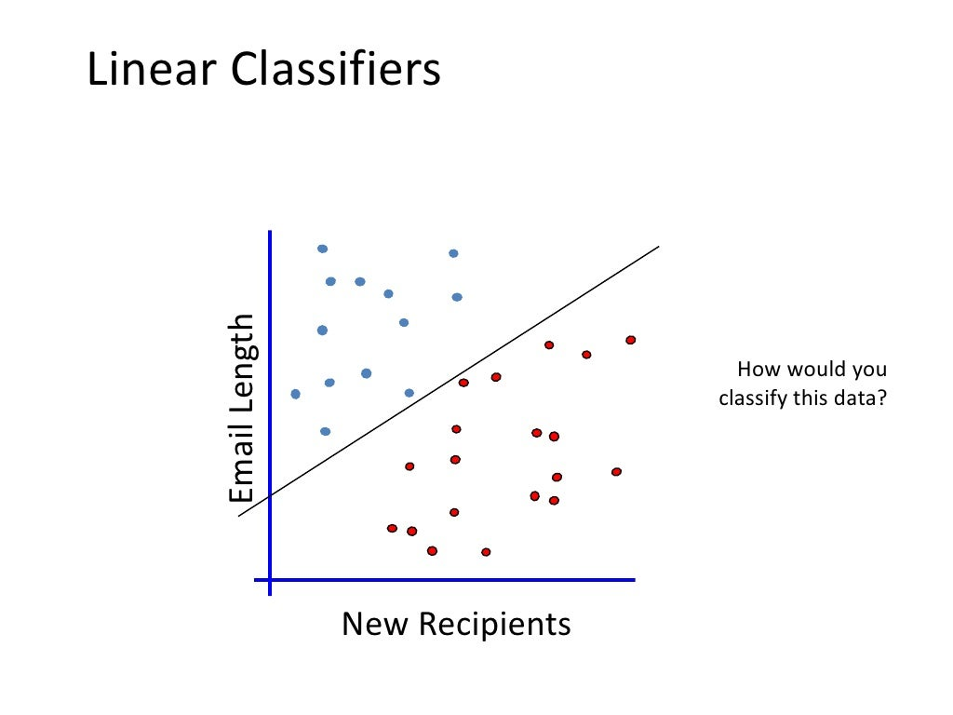

Slide 14
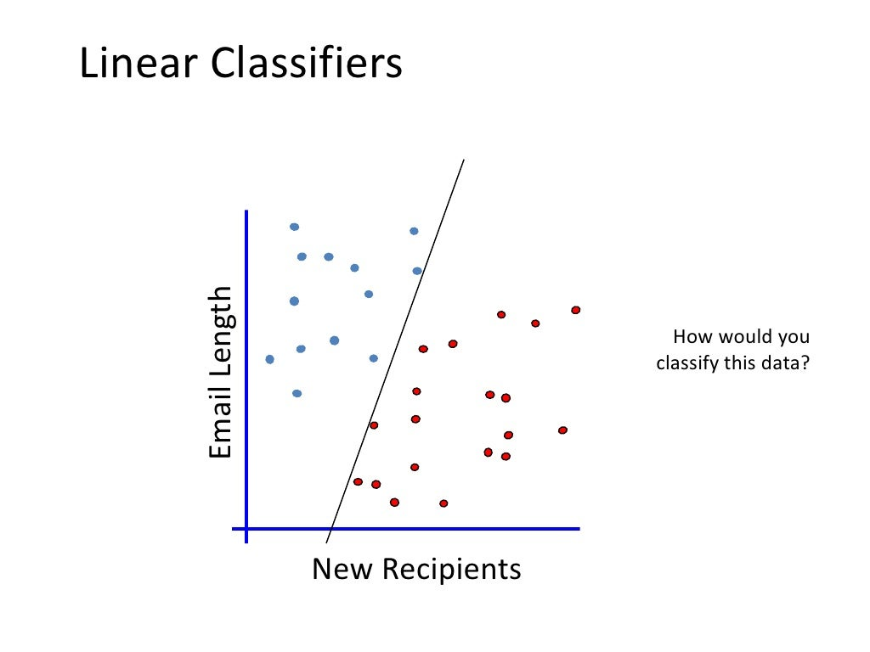

Slide 15
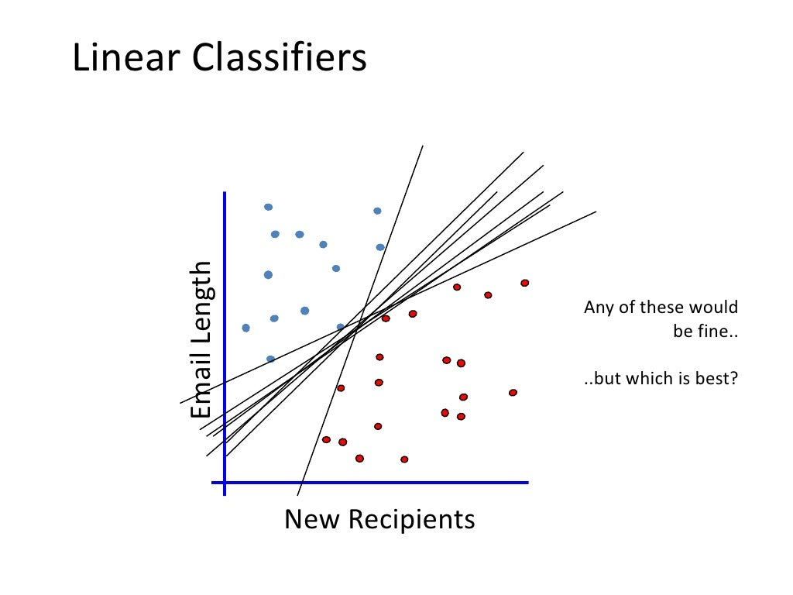

Slide 16
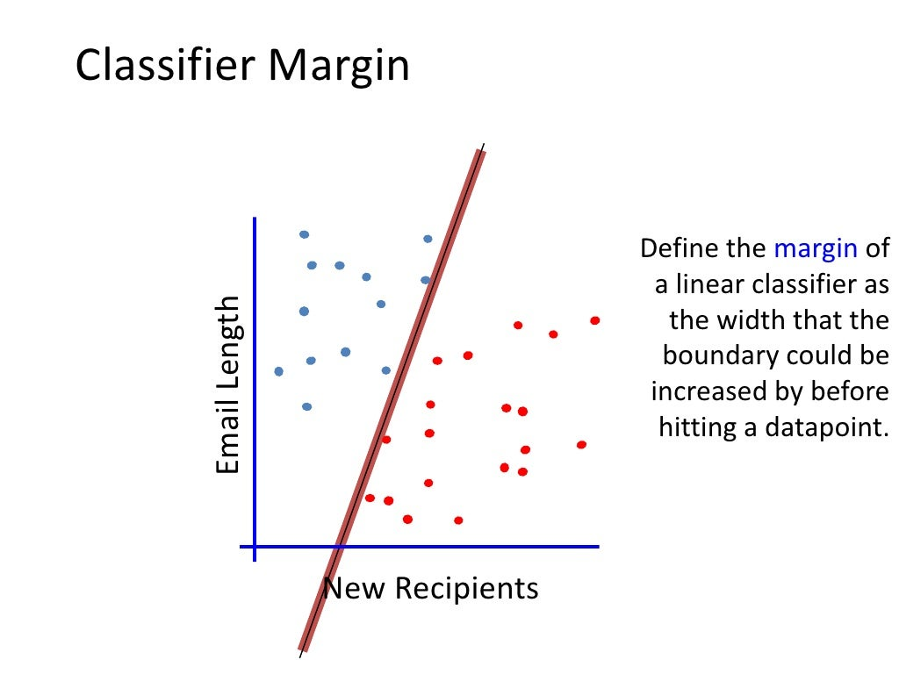

Slide 17
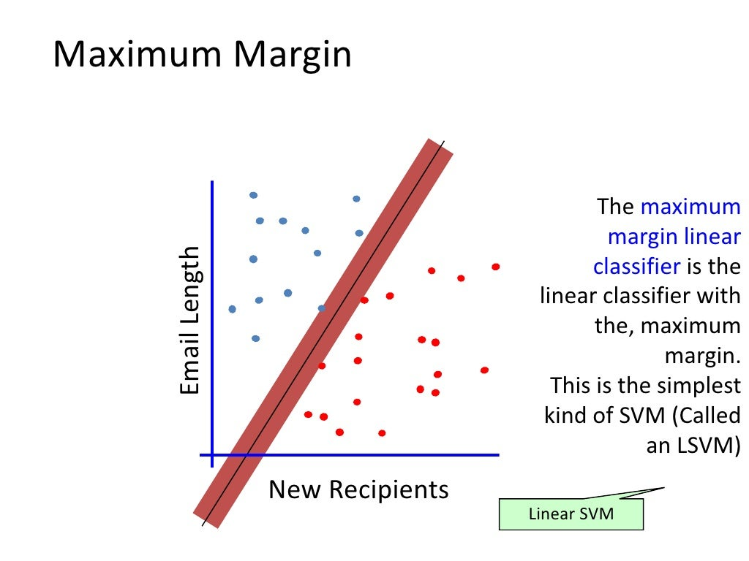

Slide 18
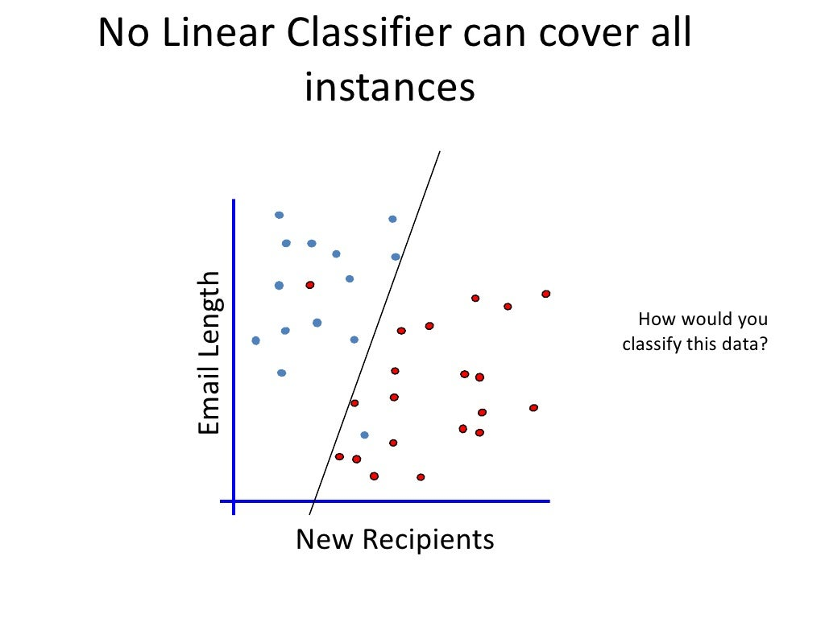

Slide 19
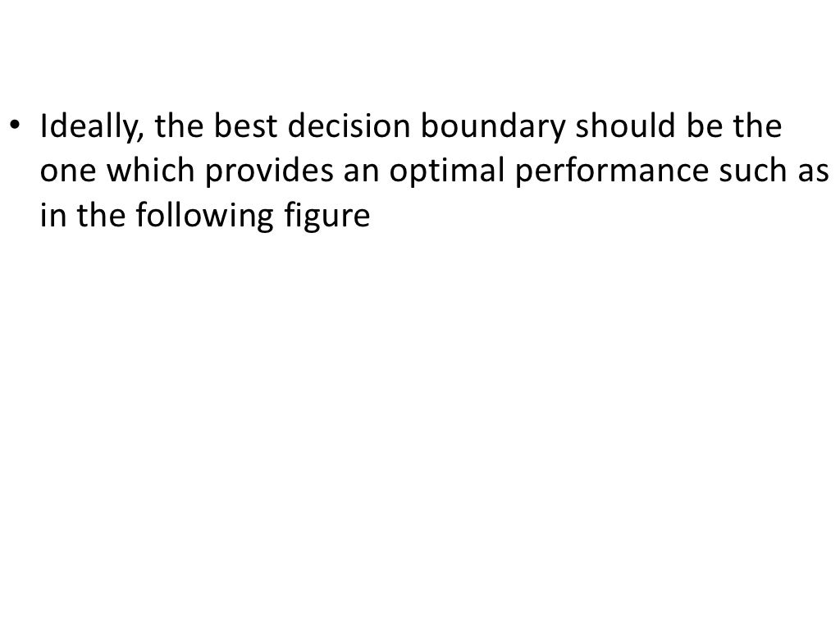

Slide 20
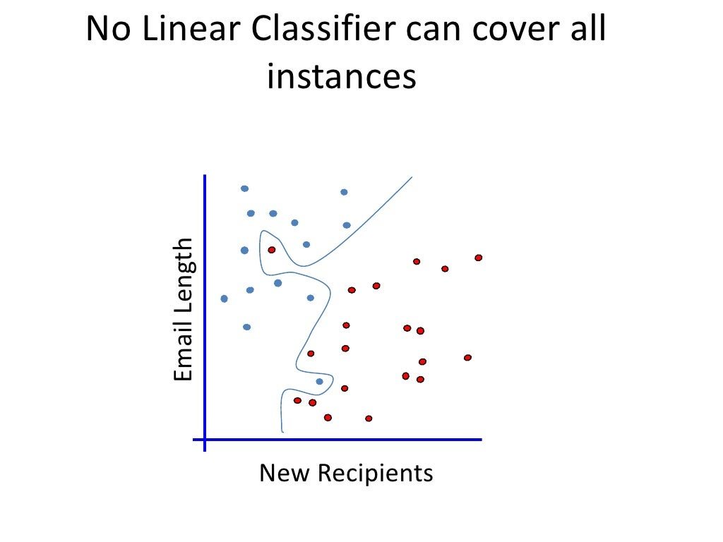

Slide 21
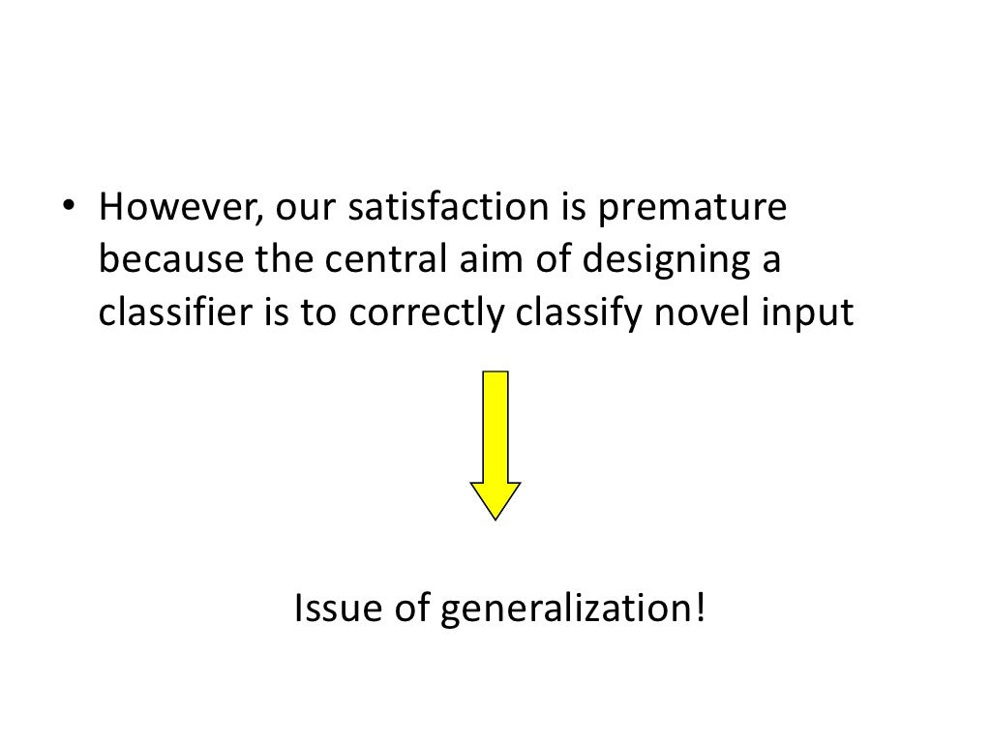

Slide 22
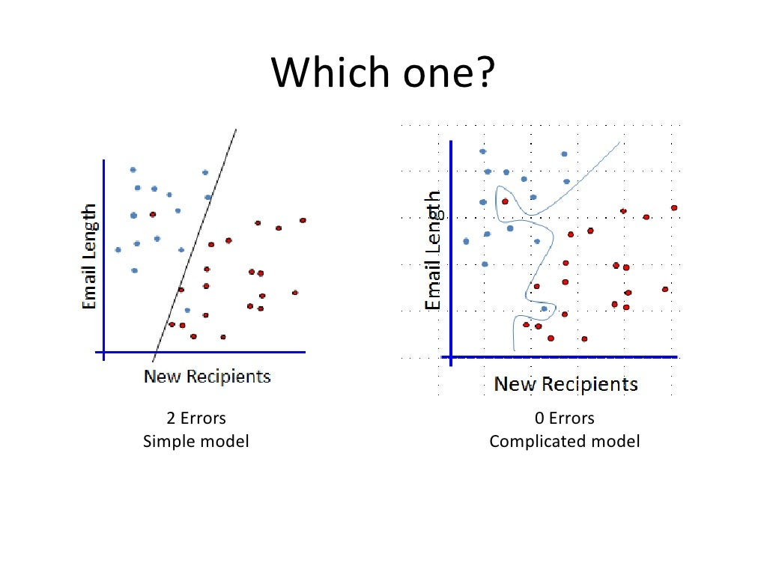

Slide 23
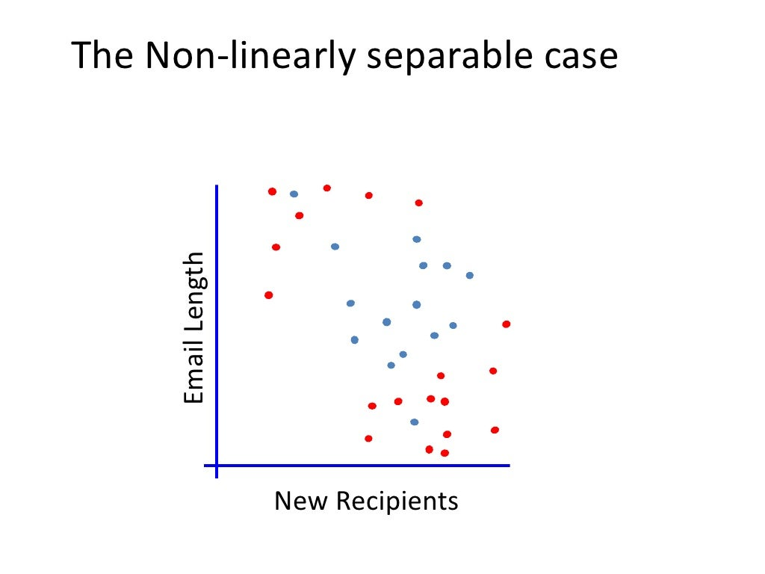

Slide 24
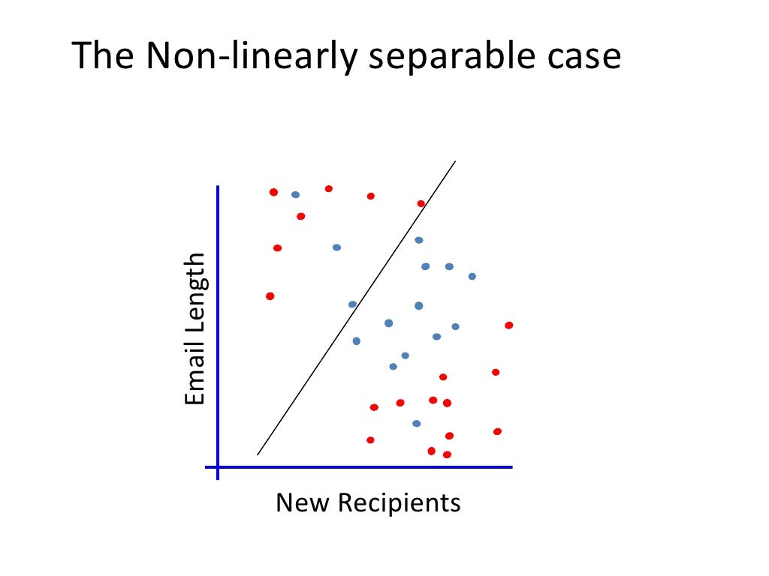

Slide 25
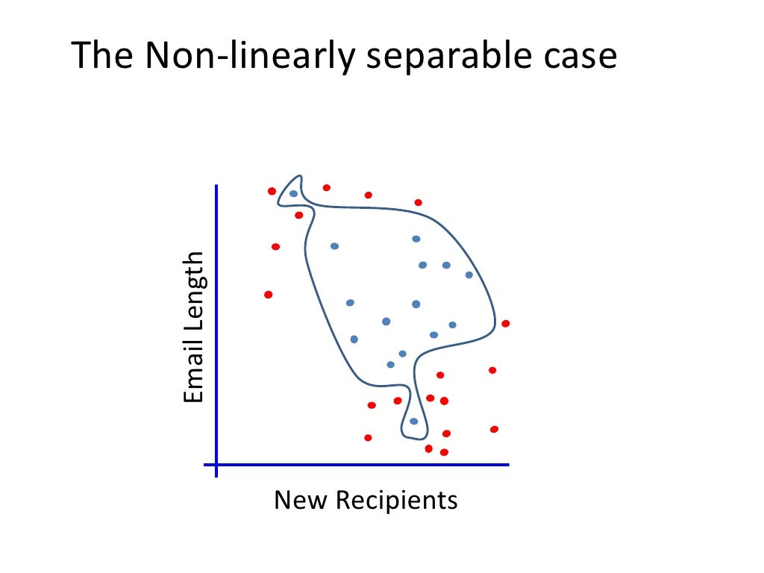

Slide 26
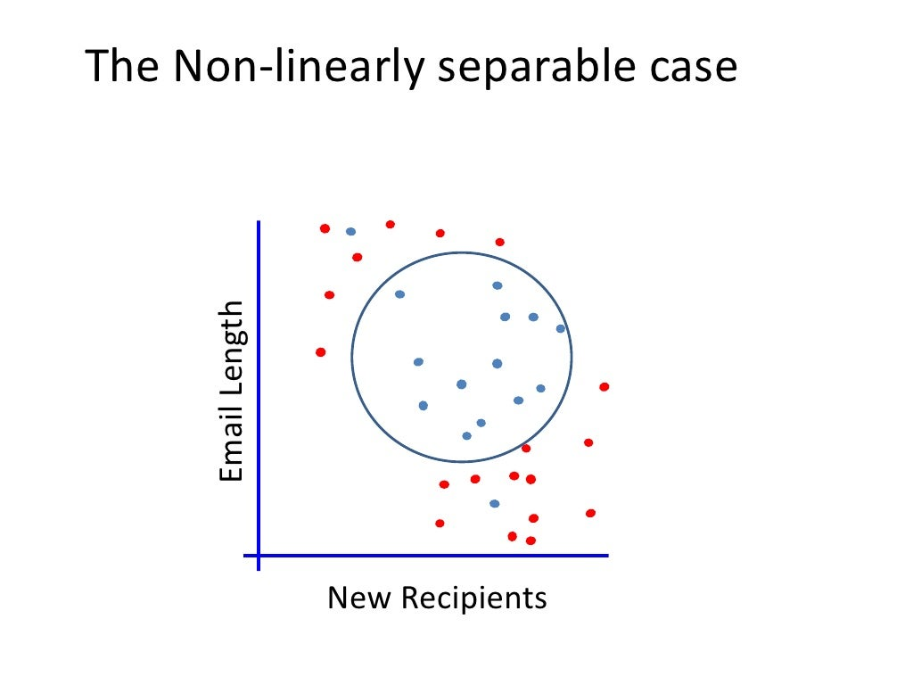

Slide 27
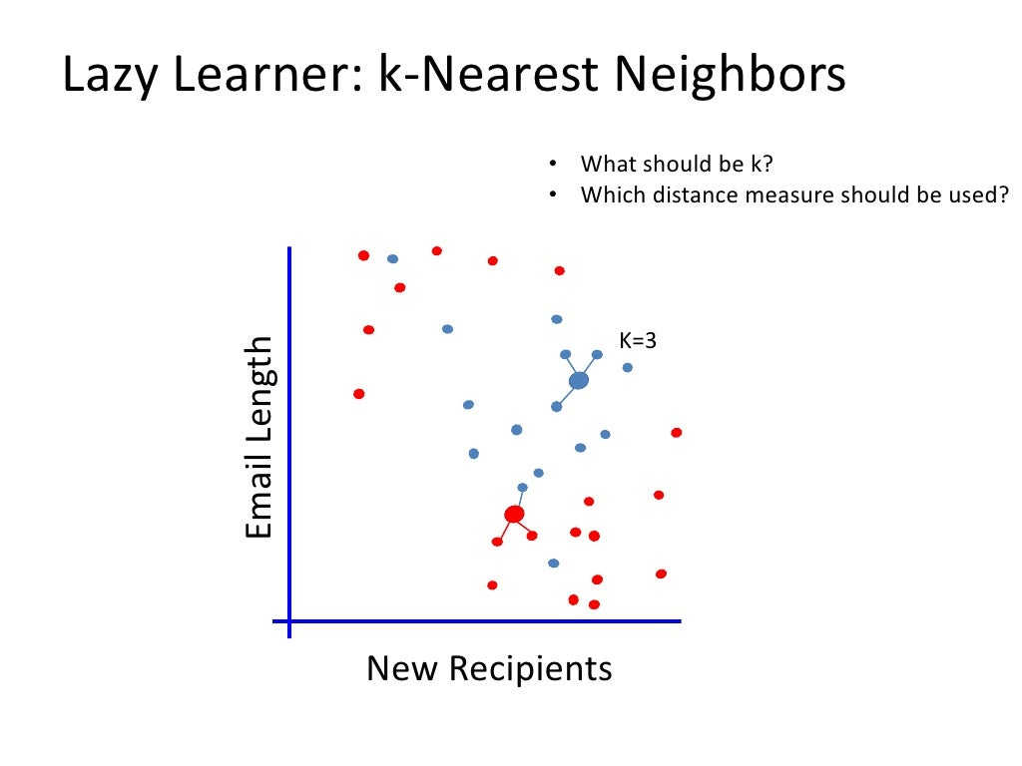

Slide 28
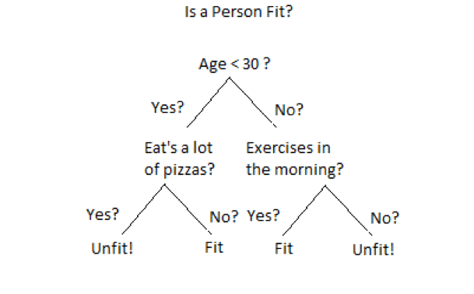
Regression/Classification: Decision Trees
Input: Finite range of Continuous Values/Categorical.
Output: Finite range of Continuous Values/Categorical.

Slide 29

Regression/Classification: Random Forest
Input: Finite range of Continuous Values/Categorical.
Output: Finite range of Continuous Values/Categorical.

Slide 30
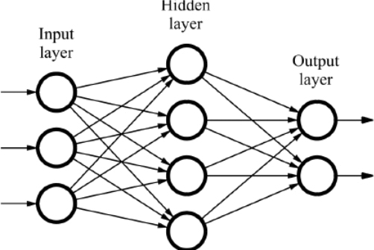
Regression/Classification: Neural Network
Input: Finite range of Continuous Values.
Output: Finite range of Continuous Values/Categorical.

Slide 31
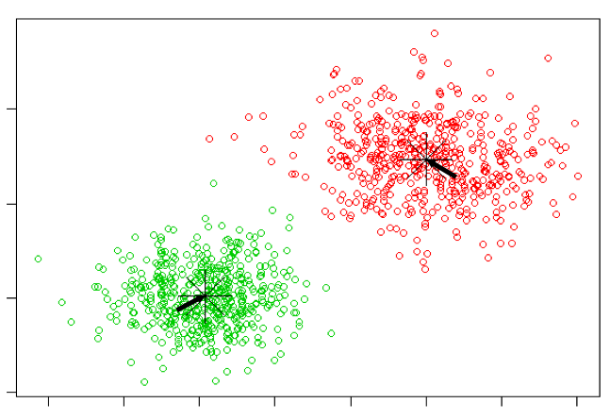
Clustering: K-Means
Input: Finite range of Continuous Values.

Slide 32


